Slide 1
Reproducing the Tables and
Choosing the Integrator
Based on A. Lima-Silva and F. D. Freitas, "Exploring a Dynamic Homotopy Technique to Enhance the Convergence of Classical Power Flow Iterative Solvers in Ill-Conditioned Power System Models", Energies 17(18):4642, 2024
Presented by Sizan · Team: 2105039, 2105040, 2105057, 2105058, 2105060
CSE 402 Numerical Analysis Sessional
Notes:
We implemented the paper from scratch in Python, reproduced its results, and then tested changes to the method. First the paper, then our implementation and reproduction, then the improvements.

Slide 2
My part of the project
1
Reproduce Tables 2 to 5
2
Figure 3 and Table 6
FE, RK2 and BE along the path, our value next to the paper's
five-point paths and a fair timing benchmark
3
Other step rules
4
Tune δ
RK4 and BE-chord: does a better integrator help?
golden-section search for the best shift on every grid
Sizan's part · Lima-Silva & Freitas (2024): reproduction and improvements
2
Notes:
Two questions: do we get the paper's numbers, and is the paper's choice of integrator and of delta the right one? Items 1 and 2 answer the first, 3 and 4 the second.

Slide 3
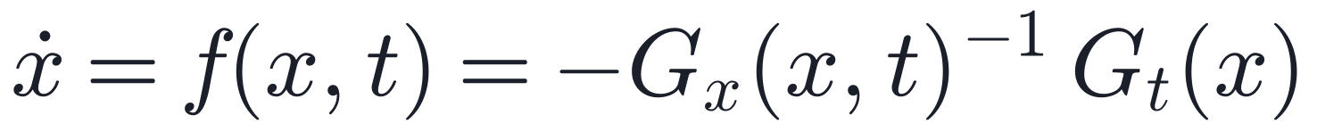
Four ways to take a step along the path
Scheme | Step | LUs | Type
Forward Euler | xₖ₊₁ = xₖ + Δt f(xₖ, tₖ) | 1 | explicit
Backward Euler (paper) | xₖ₊₁ = xₖ + Δt f(xₖ, tₖ₊₁) | 1 | implicit
RK2 | average of 2 slopes | 2 | explicit
RK4 (added) | weighted average of 4 slopes | 4 | explicit
Every slope costs one sparse LU, so cost = number of LUs.
Sizan's part · Lima-Silva & Freitas (2024): reproduction and improvements
3
Notes:
The homotopy turns root finding into an ODE. All schemes only differ in where the slope is taken. BE takes it at the new time t_k+1; the paper solves it with a single fixed-point iteration.

Slide 4
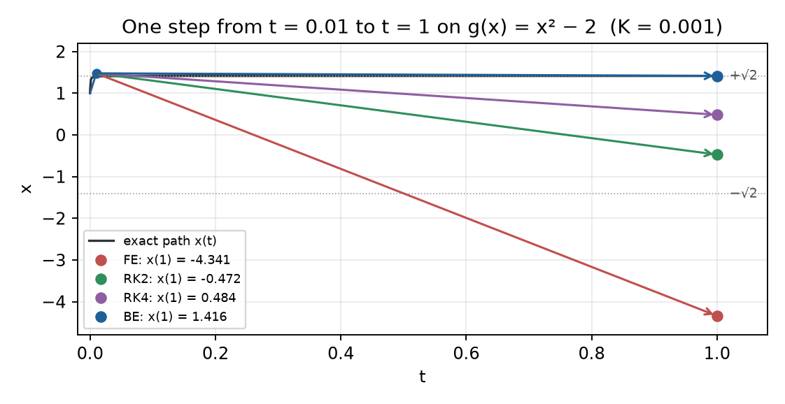
One big step, worked by hand
g(x) = x² − 2
start x = 1, K = 0.001
one BE step to t = 0.01, then one step to t = 1
FE → −4.34
Newton finds the wrong root, −√2
BE → 1.416
Newton converges in 2 iterations
Sizan's part · Lima-Silva & Freitas (2024): reproduction and improvements
4
Notes:
One unknown is enough to see Tables 2 to 4. After the same first BE step, FE lands at -4.34 and NR goes to the negative root. RK2 lands at -0.47 (also wrong root), RK4 at 0.48, BE at 1.416. Every number was computed by hand and checked with our code.

Slide 5
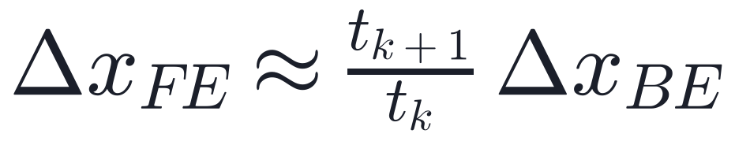
Why backward Euler wins
FE overshoots
BE is a Newton step
FE uses Gₓ at the old time, about tₖ J: far too small
step 0.01 → 0.51: about 51× too long
because G is linear in t and G(xₖ, tₖ) = 0
one Newton step on the next problem
Table 5 steps grow slowly (ratio ≤ 6), so there FE survives.
Sizan's part · Lima-Silva & Freitas (2024): reproduction and improvements
5
Notes:
FE and the paper's BE use the same G_t and differ only in which G_x they invert. G_x(t) is about t J, so the FE step is about t_k+1/t_k times the BE step. And since G(x, t_k+1) = G(x, t_k) + dt G_t(x), BE is exactly one Newton step on G(., t_k+1) = 0 when x_k is on the path.

Slide 6
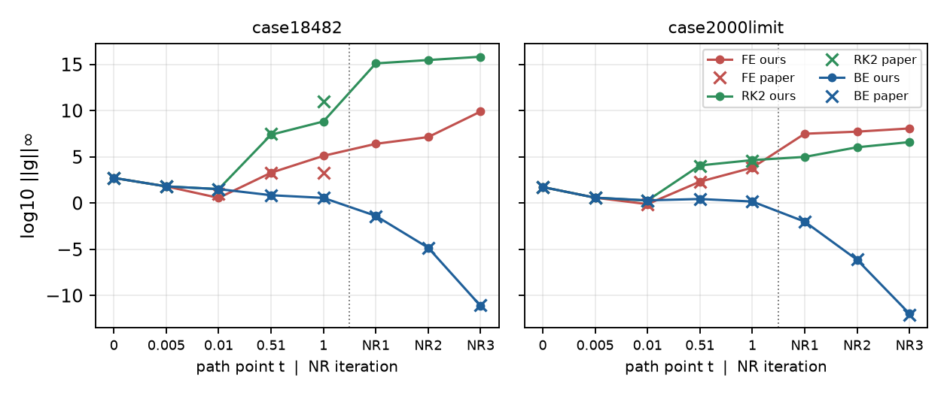
Tables 2 to 4: reproduced
Newton converges after: FE 3 of 9 · RK2 2 of 9 · BE 9 of 9 — the same as the paper
Sizan's part · Lima-Silva & Freitas (2024): reproduction and improvements
6
Notes:
Lines are ours, crosses are the paper's. BE matches digit for digit: 532, 65, 33, 7.2, 3.7, then 0.04, 1.5e-5, 1e-11 on case18482. FE and RK2 blow up at the big step 0.01 to 0.51 on the same grids as in the paper.

Slide 7
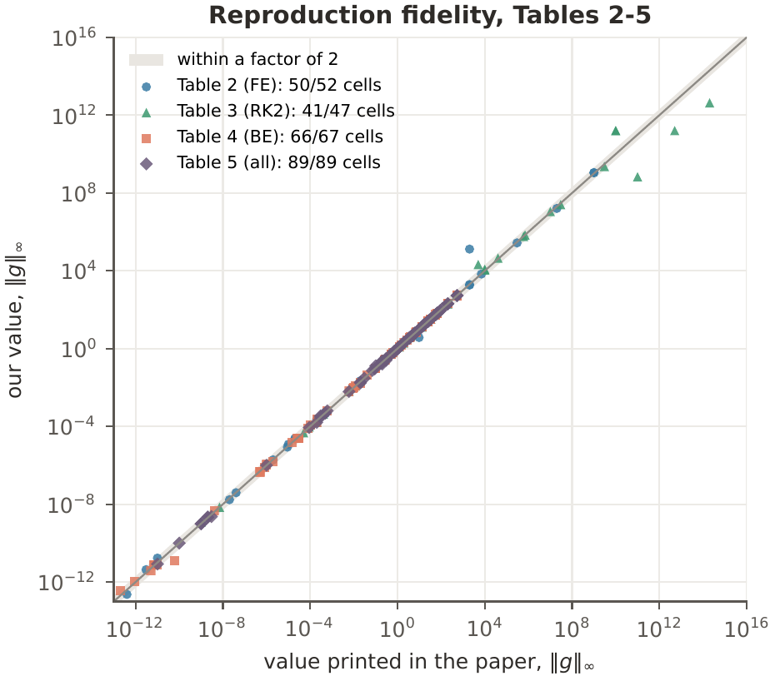
How close is the reproduction?
246 / 255
table cells within a factor of 2 of the paper (96%)
199 / 255
within 10%, as close as two printed digits allow
Outliers: values of runs that already diverged, and one cell (9.7 vs 3.7) that looks like a typo.
Sizan's part · Lima-Silva & Freitas (2024): reproduction and improvements
7
Notes:
Every numeric cell of Tables 2 to 5, paper against ours, on log axes across 28 orders of magnitude. Seven outliers are divergent FE/RK2 values above 1e3, one is a final NR value near 1e-11, and one is Table 2, FE on case18482 at t = 0.01.

Slide 8
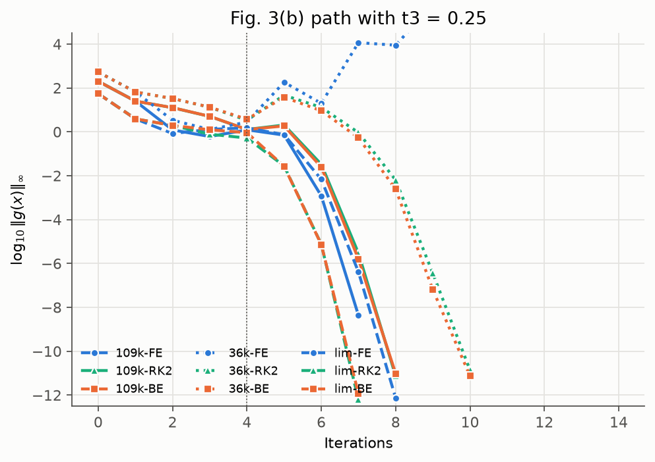
Figure 3 and Table 6: five-point paths
case109272, % of NR-MAT time
t₃ = 0.20 | Ours | Paper
FE | 143% | 146%
RK2 | 225% | 230%
BE | 163% | 171%
paper's failure reproduced (FE, t₃ = 0.25)
median of 7 interleaved runs
Sizan's part · Lima-Silva & Freitas (2024): reproduction and improvements
8
Notes:
Path {0, 0.05, 0.1, t3, 1}. Single timings on a laptop varied up to 4 times, so methods run in turn and we take the median of seven. On the largest grid we are within 13 points of the paper in every row. On case2000limit we are not: the paper reports the hybrid faster than NR-MAT, which is impossible since it does strictly more work.

Slide 9
A better integrator? RK4 and BE-chord
Step rule (fixed steps) | Solved of 170 | Why
Backward Euler (paper) | 127
BE-chord (3 iterations, 1 LU) | 89 | iteration does not contract for Δt ≈ 1
RK4 | 13 | explicit: every stage overshoots
Higher order does not help when the step is outside the stability region.
Sizan's part · Lima-Silva & Freitas (2024): reproduction and improvements
9
Notes:
The paper suggests more fixed-point iterations for BE and mentions higher order methods as future work. Both make things worse with the paper's big steps. BE-chord: the iteration factor is about -dt, close to -1, so the iterates oscillate. RK4: four explicit slopes, each far off the path.

Slide 10
A fair test: every rule picks its own steps
Mean LUs per run with Richardson step control (with Sadman)
BE is still
3.5× to 8×
cheaper
The ODE is stiff: implicit beats high order.
Sizan's part · Lima-Silva & Freitas (2024): reproduction and improvements
10
Notes:
Fixed big steps are unfair to explicit rules, so we let each choose its step from a Richardson error estimate. FE and RK2 then solve a few more runs (157, 158 vs 151) but at 3.5 to 4.5 times the cost. RK4 solves fewer (145) at 8 times the cost. The paper's choice of BE survives a fair comparison.

Slide 11
Golden-section search
Minimise
number of LUs of the whole solve
Over
log₁₀ δ ∈ [−4, 1], then log₁₀ Δt₀
Cost
11 + 10 = 21 solves per grid
a
c
d
b
keep [a, d] if f(c) ≤ f(d), else [c, b]
one point is reused: one new solve per step
Sizan's part · Lima-Silva & Freitas (2024): reproduction and improvements
11
Notes:
Golden-section needs only function values, which suits an integer LU count with no derivative. r^2 = 1 - r lets one interior point be reused, so each iteration costs one solve and shrinks the interval by 0.618. A failed run costs 50 LUs, and a small tie-break on the final mismatch lets the search move across flat stretches. It returns the best point seen.

Slide 12
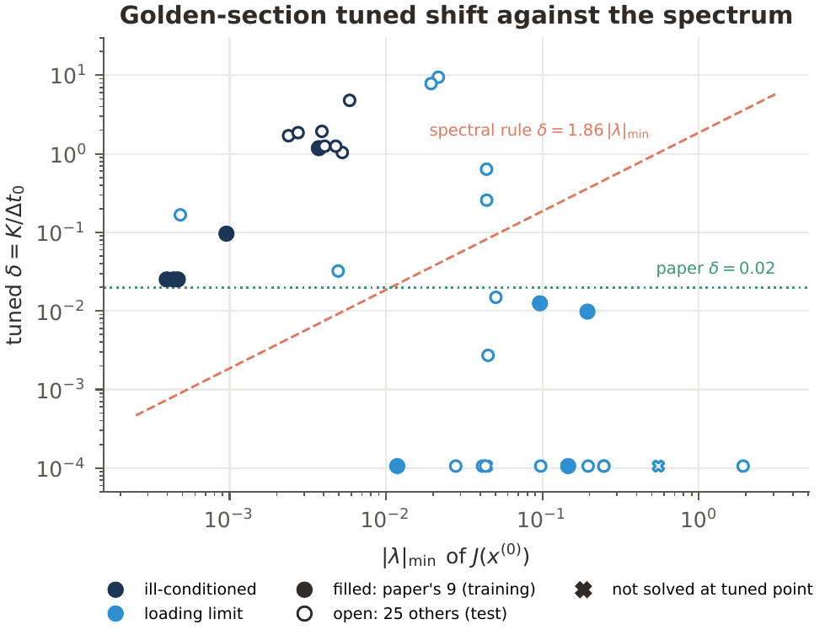
What tuning δ showed
Rules fitted on 9 grids, tested on 25
How δ is chosen | Test solved
paper, δ = 0.02 | 19 / 25
fixed, δ = 0.011 | 19 / 25
spectral, 1.86 |λ|min | 20 / 25
golden search | 23 / 25
best δ: 0.025 to 4.8 on ill-conditioned grids
search wins, but costs 21 solves
Sizan's part · Lima-Silva & Freitas (2024): reproduction and improvements
12
Notes:
The paper's 0.02 is right for three of its own grids (search finds 0.025), but other ill-conditioned grids want 1 to 5. The spectral rule fails: tuned delta is 54 to 819 times lambda_min, and it loses 4 of its own 9 training grids. A per-grid search solves 4 more test grids but is too expensive.

Slide 13
Summary
Tables 2 to 6 and Figure 3 reproduced: 96% of cells within 2× of the paper
FE overshoots by tₖ₊₁ / tₖ; BE is a Newton step on the next problem
RK4 and BE-chord do worse; under error control BE is still the cheapest
The best δ differs per grid, and no simple rule predicts it
Thank you. Questions?
Sizan's part · Lima-Silva & Freitas (2024): reproduction and improvements
13

